Slide 1
Advanced widgets
Thai Duy Quy

Slide 2


Android Selection Widgets

Slide 3
Selection Widgets
RadioButtons and CheckButtons are suitable for selecting from a small set of options.
When the pool of choices is larger other widgets are more appropriate, those include classic UI controls such as: listboxes, comboboxes, drop-down lists, picture galleries, etc.
Android data adapter provides a common interface to selection lists ranging from small arrays to large database contents.
Selection views – widgets for presenting lists of choices – are handed an adapter to supply the actual choices.
3

Slide 4
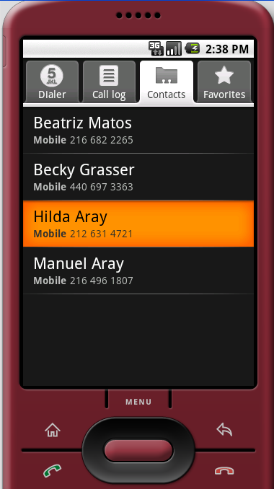
Selection Widgets
Displaying/Selecting Options
Selection
DATA
Raw data
Formatted & bound
data
DATA
ADAPTER
Destination layout
Holding a ListView
4

Slide 5
Using ArrayAdapter
The simplest adapter is ArrayAdapter. You just wrap one around a Java array or java.util.List instance from inside a ListActivity (caution: not an Activity…).
String[] items={"this", "is", "a","really", "silly", "list"};
new ArrayAdapter<String>(this,
android.R.layout.simple_list_item_1,
items);
The ArrayAdapter constructor takes three parameters:
The Context to use (typically this will be your activity instance)
The resource ID of a UI destination view to use ( usually a ListView , such as the built-in system resource : android.R.layout.simple_list_item_1 shown above)
The actual source array or list of items to show
5

Slide 6
6. Android – UI – Selection Widgets
Selection Widgets
Example 1: A simple list (1 of 4)
Instead of Activity we will use a ListActivity which is an Android class specializing in
the use of ListViews.
<?xml version="1.0" encoding="utf-8"?>
<LinearLayout
xmlns:android="http://schemas.android.com/apk/res/android"
android:orientation="vertical"
android:layout_width="fill_parent"
android:layout_height="fill_parent" >
<TextView
android:id="@+id/selection"
android:layout_width="fill_parent"
android:layout_height="wrap_content"
android:background="#ff0000cc"
android:textStyle="bold“ />
<!-- Here is the list. Since we are using a ListActivity, we have to call it "@android:id/list" so ListActivity will find it --> <ListView
android:id="@android:id/list"
android:layout_width="fill_parent"
android:layout_height="fill_parent"
android:drawSelectorOnTop="false" />
<TextView android:id="@android:id/empty"
android:layout_width="wrap_content"
android:layout_height="wrap_content"
android:text="Empty set" />
</LinearLayout>
Android’s built-in list layout
Used on empty lists
6

Slide 7
6. Android – UI – Selection Widgets
Selection Widgets
Example 1 : A simple list (2 of 4)
package cis493.selectionwidgets;
import android.app.ListActivity;
import android.os.Bundle;
import android.view.View;
import android.widget.ArrayAdapter;
import android.widget.ListView;
import android.widget.TextView;
public class ArrayAdapterDemo extends ListActivity {
TextView selection;
String[] items = { "this", "is", "a", "really",
"really2", "really3","really4",
"really5", "silly", "list" };
// next time try an empty list such as:
// String[] items = {};
Data source
NOTE: The ListActivity class is implicitly bound to an object identified by @android:id/list
7

Slide 8
6. Android – UI – Selection Widgets
Selection Widgets
Example 1: A simple list (3 of 4)
@Override
public void onCreate(Bundle savedInstanceState) {
super.onCreate(savedInstanceState);
setContentView(R.layout.main);
setListAdapter(new ArrayAdapter<String>(
this,
android.R.layout.simple_list_item_1,
items));
selection=(TextView)findViewById(R.id.selection);
}
@Override
protected void onListItemClick(ListView l, View v,
int position, long id) {
super.onListItemClick(l, v, position, id);
String text = " position:" + position + " " + items[position];
selection.setText(text);
}
}
List adapter
Selection listener
8

Slide 9
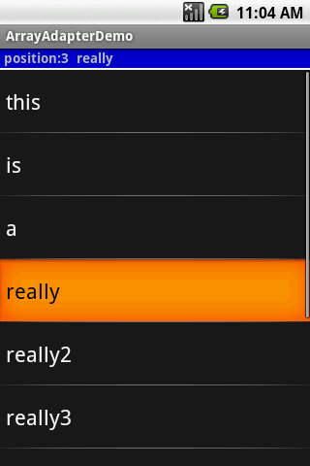
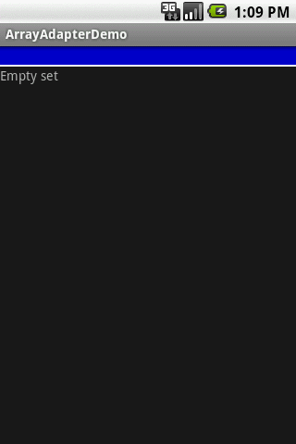
6. Android – UI – Selection Widgets
Selection Widgets
Example 1: A simple list (4 of 4)
Selection seen
by the listener
When you click here
background flashes orange
9

Slide 10


6. Android – UI – Selection Widgets
Selection Widgets
Observations on Example1.
This example uses a number of predefined Android components.
In the XML layout we reference a built-in ListView widget called android:id/list
(includes: multiple lines, black /orange background, light-gray separator line, horiz/vert. scroll-bar)
Later in the setting of the ArrayAdapter we use android.R.layout.simple_list_item_1
(indicates how to display a single line of data)
10

Slide 11

6. Android – UI – Selection Widgets
Selection Widgets
A Variation on Example1.
You may use a common Activity instead of a ListActivity. Define a custom ListView (other than @android:id/list). Set the adapter to your new ListView.
public class Main extends Activity {
ListView myListView;
@Override
public void onCreate(Bundle savedInstanceState) {
super.onCreate(savedInstanceState);
setContentView(R.layout.main);
myListView = (ListView) findViewById(R.id.ListView01);
final String[] items={"this", "is", "a","really", "really2",
"really3", "really4", "really5", "silly", "list"};
ArrayAdapter<String> ad = new ArrayAdapter<String>(this,
android.R.layout.simple_list_item_1,
items);
myListView.setAdapter(ad);
}
}
11

Slide 12
6. Android – UI – Selection Widgets
Selection Widgets
A Variation on Example1 (cont.)
To provide a listener to the ListView control add the following fragment to the onCreate method.
myListView.setOnItemClickListener(new OnItemClickListener() {
@Override
public void onItemClick(AdapterView<?> av, View v, int position, long id) {
String text = "\n av: " + av.toString()
+ "\n v: " + v.toString()
+ "\n pos:" + position
+ "\n id: " + id
+ "\n data:" + items[position];;
Toast.makeText(getApplicationContext(), text, 1).show();
}
});
12

Slide 13

6. Android – UI – Selection Widgets
Selection Widgets
Spin Control
In Android, the Spinner is the equivalent of the drop-down selector.
As with ListView, you provide the adapter for linking data to child views using setAdapter()
Add a listener object to capture selections made from the list with setOnItemSelectedListener().
Use the setDropDownViewResource() method to supply the resource ID of the multi-line selection list view to use.
13

Slide 14
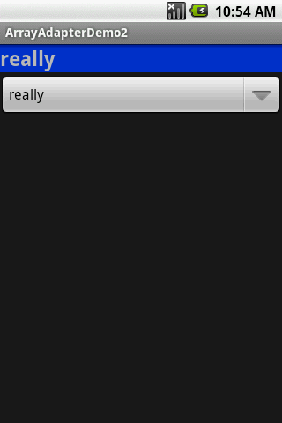
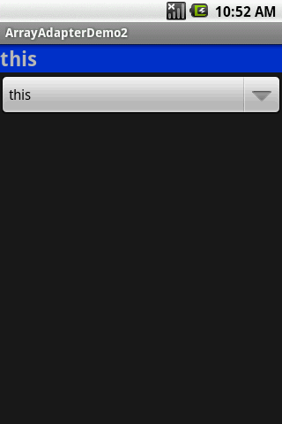
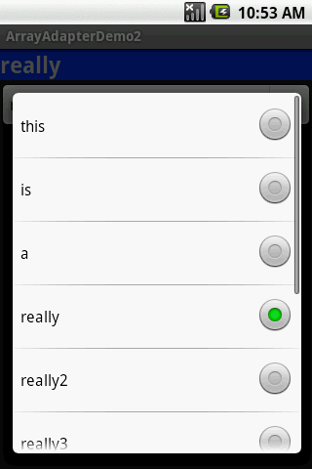
6. Android – UI – Selection Widgets
Selection Widgets
Example 2. Using the Spinner
3. Selected value
1. Click here
2. Select this option
14

Slide 15
6. Android – UI – Selection Widgets
Selection Widgets
Example 2. Using the Spinner
<?xml version="1.0" encoding="utf-8"?>
<LinearLayout
android:id="@+id/myLinearLayout"
android:layout_width="fill_parent"
android:layout_height="fill_parent"
android:orientation="vertical"
xmlns:android="http://schemas.android.com/apk/res/android"
>
<TextView
android:id="@+id/selection"
android:layout_width="fill_parent"
android:layout_height="wrap_content"
android:background="#ff0033cc"
android:textSize="14pt"
android:textStyle="bold"
>
</TextView>
<Spinner
android:id="@+id/spinner"
android:layout_width="fill_parent"
android:layout_height="wrap_content"
>
</Spinner>
</LinearLayout>
You choose the name
15

Slide 16
6. Android – UI – Selection Widgets
Selection Widgets
Example 2. Using the Spinner
package cis493.selectionwidgets;
import android.app.Activity;
import android.os.Bundle;
import android.view.View;
import android.widget.AdapterView;
import android.widget.ArrayAdapter;
import android.widget.Spinner;
import android.widget.TextView;
public class ArrayAdapterDemo2 extends Activity
implements AdapterView.OnItemSelectedListener {
TextView selection;
String[] items = { "this", "is", "a",
"really", "really2", "really3",
"really4", "really5", "silly", "list" };
16

Slide 17
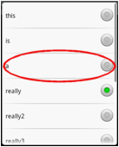
6. Android – UI – Selection Widgets
Selection Widgets
Example 2. Using the Spinner
@Override
public void onCreate(Bundle icicle) {
super.onCreate(icicle);
setContentView(R.layout.main);
selection = (TextView) findViewById(R.id.selection);
Spinner spin = (Spinner) findViewById(R.id.spinner);
spin.setOnItemSelectedListener(this);
// bind array to UI control to show one-line
ArrayAdapter<String> aa = new ArrayAdapter<String>(
this, android.R.layout.simple_spinner_item, items);
// showing the drop-down multi-line window
aa.setDropDownViewResource(
android.R.layout.simple_spinner_dropdown_item);
// associate GUI spinner and adapter
spin.setAdapter(aa);
}
// ////////////////////////////////////////////////////////////////////
public void onItemSelected(
AdapterView<?> parent, View v, int position, long id) {
selection.setText(items[position]);
}
public void onNothingSelected(AdapterView<?> parent) {
selection.setText("");
}
}
17

Slide 18
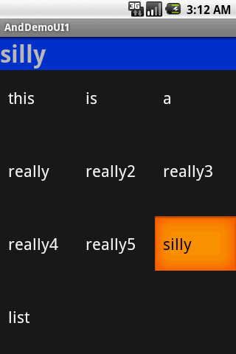
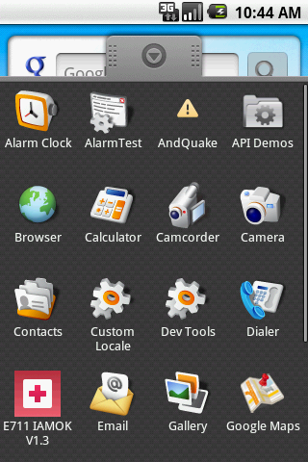
6. Android – UI – Selection Widgets
Selection Widgets
GridView
GridView is a ViewGroup that displays items in a two-dimensional, scrollable grid.
The grid items are automatically inserted to the layout using a ListAdapter.
18

Slide 19
6. Android – UI – Selection Widgets
Selection Widgets
GridView
Some properties used to determine the number of columns and their sizes:
android:numColumns spells out how many columns there are
android:verticalSpacing and its counterpart android:horizontalSpacing indicate how much whitespace there should be between items in the grid.
android:columnWidth indicates how many pixels wide each column should be.
android:stretchMode indicates, for grids with auto_fit for android:numColumns, what should happen for any available space not taken up by columns or spacing .
19

Slide 20
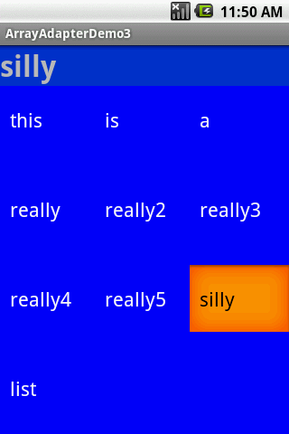
6. Android – UI – Selection Widgets
Selection Widgets
Example 3. GridView
<?xml version="1.0" encoding="utf-8"?>
<LinearLayout
xmlns:android="http://schemas.android.com/apk/res/android"
android:orientation="vertical"
android:layout_width="fill_parent"
android:layout_height="fill_parent"
>
<TextView
android:id="@+id/selection"
android:layout_width="fill_parent"
android:layout_height="wrap_content"
android:background="#ff0033cc"
android:textSize="14pt"
android:textStyle="bold"
/>
<GridView
android:id="@+id/grid“
android:background="#ff0000ff"
android:layout_width="fill_parent"
android:layout_height="fill_parent"
android:verticalSpacing="35px"
android:horizontalSpacing="5px"
android:numColumns="auto_fit"
android:columnWidth="100px"
android:stretchMode="columnWidth"
android:gravity="center"
/>
</LinearLayout>
20

Slide 21
6. Android – UI – Selection Widgets
Selection Widgets
Example 3. GridView
package cis493.selectionwidgets;
// using a gridview
import android.app.Activity;
import android.os.Bundle;
import android.view.View;
import android.widget.AdapterView;
import android.widget.ArrayAdapter;
import android.widget.GridView;
import android.widget.TextView;
public class ArrayAdapterDemo3 extends Activity
implements AdapterView. OnItemClickListener {
TextView selection;
String[] items = { "this", "is", "a",
"really", "really2", "really3",
"really4", "really5", "silly", "list" };
21

Slide 22
6. Android – UI – Selection Widgets
Selection Widgets
Example 3. GridView
@Override
public void onCreate(Bundle icicle) {
super.onCreate(icicle);
setContentView(R.layout.main);
selection = (TextView) findViewById(R.id.selection);
GridView gv = (GridView) findViewById(R.id.grid);
ArrayAdapter<String> aa = new ArrayAdapter<String>(
this,
android.R.layout.simple_list_item_1,
items );
gv.setAdapter(aa);
gv.setOnItemClickListener(this);
}
public void onItemClick(AdapterView<?> parent, View v,
int position, long id) {
selection.setText(items[position]);
}
}// class
22

Slide 23
6. Android – UI – Selection Widgets
Selection Widgets
GridView
A –perhaps-- more interesting version of the GridView control uses images instead of text.
The programmer must supply an ImageAdapter to indicate what to do when an individual image is selected/clicked.
The following example illustrates how to use this control.
23

Slide 24
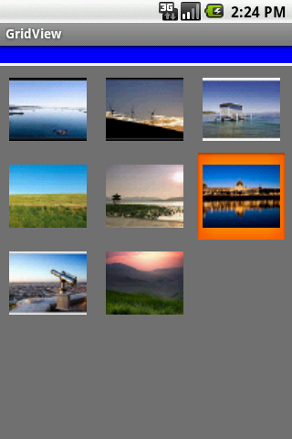
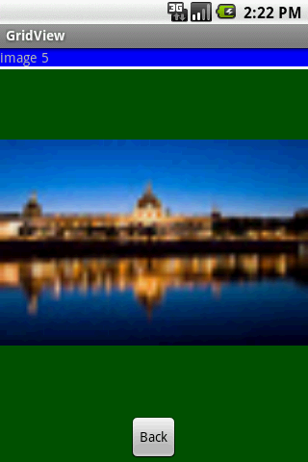
6. Android – UI – Selection Widgets
Selection Widgets
GridView
A –perhaps-- more interesting version of the GridView control uses images instead of text.
The programmer must supply a modified BaseAdapter to indicate what to do when an individual image is selected/clicked.
The following example illustrates how to use this control.
24

Slide 25
6. Android – UI – Selection Widgets
Selection Widgets
GridView
main.xml
<?xml version="1.0" encoding="utf-8"?>
<LinearLayout xmlns:android="http://schemas.android.com/apk/res/android"
android:orientation="vertical"
android:layout_width="fill_parent"
android:layout_height="fill_parent"
>
<TextView
android:id="@+id/tvMsg"
android:layout_width="fill_parent"
android:layout_height="wrap_content"
android:background="#ff0000ff"
/>
<TextView
android:layout_width="fill_parent"
android:layout_height="3px"
android:background="#ffffffff"
/>
<GridView
android:id="@+id/gridview"
android:layout_width="fill_parent"
android:layout_height="fill_parent"
android:numColumns="auto_fit"
android:verticalSpacing="10dp"
android:horizontalSpacing="10dp"
android:columnWidth="90dp"
android:stretchMode="columnWidth"
android:gravity="center"
android:background="#ff777777" />
</LinearLayout>
25

Slide 26
6. Android – UI – Selection Widgets
Selection Widgets
GridView
solo_picture.xml
<?xml version="1.0" encoding="utf-8"?>
<LinearLayout xmlns:android="http://schemas.android.com/apk/res/android"
android:orientation="vertical"
android:layout_width="fill_parent"
android:layout_height="fill_parent"
android:background="#ff005500" >
<TextView
android:id="@+id/tvSoloMsg"
android:layout_width="fill_parent"
android:layout_height="wrap_content"
android:background="#ff0000ff" />
<TextView
android:layout_width="fill_parent"
android:layout_height="3px"
android:background="#ffffffff" />
<ImageView
android:id="@+id/imgSoloPhoto"
android:layout_width="fill_parent"
android:layout_height="fill_parent"
android:layout_gravity="center|fill"
android:layout_weight="2“ />
<Button
android:text="Back"
android:id="@+id/btnBack"
android:layout_width="wrap_content"
android:layout_height="wrap_content"
android:layout_gravity="center_horizontal" />
</LinearLayout>
26

Slide 27
6. Android – UI – Selection Widgets
Selection Widgets
GridView (again…)
package cis493.matos;
/* --------------------------------------------------------------------------
References:
Website on which you could make free thumbnails:
http: www.makeathumbnail.com/thumbnail.php
--------------------------------------------------------------------------
GOAL: displaying a number of pictures in a GridView. Example taken from:
http: developer.android.com/guide/tutorials/views/hello-gridview.html
--------------------------------------------------------------------------
Reference: http://developer.android.com/guide/practices/screens_support.html
px Pixels - corresponds to actual pixels on the screen.
dp Density-independent Pixels (dip) - an abstract unit that is based on the
physical density of the screen. These units are relative to a
160 dpi screen, so one dp is one pixel on a 160 dpi screen.
--------------------------------------------------------------------------------
*/
import android.app.Activity;
import android.content.Context;
import android.os.Bundle;
import android.view.View;
import android.view.ViewGroup;
import android.view.View.OnClickListener;
import android.widget.AdapterView;
import android.widget.BaseAdapter;
import android.widget.Button;
import android.widget.GridView;
import android.widget.ImageView;
import android.widget.TextView;
import android.widget.Toast;
import android.widget.AdapterView.OnItemClickListener;
27

Slide 28
6. Android – UI – Selection Widgets
Selection Widgets
GridView (again…)
public class GridViewAct1 extends Activity implements OnItemClickListener {
TextView tvMsg;
GridView gridview;
TextView tvSoloMsg;
Integer[] mThumbIds;
ImageView ivSoloPicture;
Button btnBack;
Bundle myMemoryBundle;
@Override
public void onCreate(Bundle savedInstanceState) {
super.onCreate(savedInstanceState);
myMemoryBundle = savedInstanceState;
setContentView(R.layout.main);
tvMsg = (TextView )findViewById(R.id.tvMsg);
//initialize array of images with a few pictures
mThumbIds = new Integer[] {
R.drawable.gallery_photo_1, R.drawable.gallery_photo_2,
R.drawable.gallery_photo_3, R.drawable.gallery_photo_4,
R.drawable.gallery_photo_5, R.drawable.gallery_photo_6,
R.drawable.gallery_photo_7, R.drawable.gallery_photo_8
};
gridview = (GridView) findViewById(R.id.gridview);
gridview.setAdapter(new ImageAdapter(this));
gridview.setOnItemClickListener(this);
}//onCreate
28

Slide 29
6. Android – UI – Selection Widgets
Selection Widgets
GridView (again…)
// this nested class could also be placed as a separated class
public class ImageAdapter extends BaseAdapter {
private Context mContext;
public ImageAdapter(Context c) {
mContext = c;
}
public int getCount() {
return mThumbIds.length;
}
public Object getItem(int position) {
Toast.makeText(getApplicationContext(), "Pos: " + position, 1).show();
return null;
}
public long getItemId(int position) {
return 0;
}
// create a new ImageView for each item referenced by the Adapter
public View getView(int position, View convertView, ViewGroup parent) {
ImageView imageView;
if (convertView == null) {
// if it's not recycled, initialize some attributes
imageView = new ImageView(mContext);
imageView.setLayoutParams(new GridView.LayoutParams(85, 85));
imageView.setScaleType(ImageView.ScaleType.CENTER_CROP);
imageView.setPadding(8, 8, 8, 8); }
else {
imageView = (ImageView) convertView;
}
imageView.setImageResource(mThumbIds[position]);
return imageView;
}
}// ImageAdapter
29

Slide 30
6. Android – UI – Selection Widgets
Selection Widgets
GridView (again…)
// a picture in the gallery view has been clicked
@Override
public void onItemClick(AdapterView<?> parent, View v, int position, long id) {
tvMsg.setText("Position: " + position +
" R.drawable.gallery_photo_" + (position+1) );
// show selected picture in an individual view
showScreen2(position);
}
//////////////////////////////////////////////////////////////////////////
private void showScreen2(int position){
// show the selected picture as a single frame
setContentView(R.layout.solo_picture);
tvSoloMsg = (TextView) findViewById(R.id.tvSoloMsg);
ivSoloPicture = (ImageView) findViewById(R.id.imgSoloPhoto);
tvSoloMsg.setText("image " + position);
ivSoloPicture.setImageResource(mThumbIds[position]);
btnBack = (Button) findViewById(R.id.btnBack);
btnBack.setOnClickListener(new OnClickListener() {
@Override
public void onClick(View v) {
// redraw the main screen beginning the whole app.
onCreate(myMemoryBundle);
}
});
}//showScreen2
//////////////////////////////////////////////////////////////////////////
}// GridViewAct1
30

Slide 31
6. Android – UI – Selection Widgets
Selection Widgets
Customized Lists
Android provides predefined row layouts for displaying simple lists. However, you may want more control in situations such as:
Not every row uses the same layout (e.g., some have one line of text, others have two)
You need to configure the widgets in the rows (e.g., different icons for different cases)
In those cases, the better option is to create your own subclass of your desired Adapter.
31

Slide 32
6. Android – UI – Selection Widgets
Selection Widgets
Customized Lists
In order to subclass your desired Adapter, you need to
override getView(), and
construct your rows yourself.
The getView() method is responsible for returning a View, representing the row for the supplied position of the adapter.
Example: Modify getView(), so we can have different icons for different rows in a list – in this case, one icon for short words and one for long words.
32

Slide 33
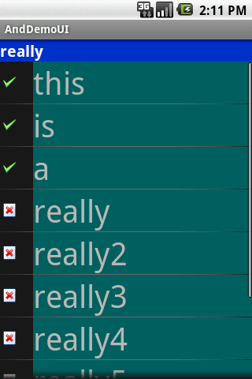
6. Android – UI – Selection Widgets
Selection Widgets
Customized Lists – Example: main.xml
<?xml version="1.0" encoding="utf-8"?>
<LinearLayout
android:id="@+id/widget28"
android:layout_width="fill_parent"
android:layout_height="fill_parent"
android:orientation="vertical"
xmlns:android="http://schemas.android.com/apk/res/android"
>
<TextView
android:id="@+id/selection"
android:layout_width="fill_parent"
android:layout_height="wrap_content"
android:background="#ff0033cc"
android:textSize="20px"
android:textStyle="bold"
android:textColor="#ffffffff"
>
</TextView>
<ListView
android:id="@android:id/list"
android:layout_width="fill_parent"
android:layout_height="fill_parent"
>
</ListView>
</LinearLayout>
33

Slide 34

6. Android – UI – Selection Widgets
Selection Widgets
Customized Lists – Example: myrow.xml
<?xml version="1.0" encoding="UTF-8"?>
<LinearLayout xmlns:android="http://schemas.android.com/apk/res/android"
android:layout_width="fill_parent"
android:layout_height="wrap_content"
android:orientation="horizontal"
>
<ImageView
android:id="@+id/icon"
android:layout_width="22px"
android:paddingLeft="2px"
android:paddingRight="2px"
android:paddingTop="2px"
android:layout_height="wrap_content"
android:src="@drawable/ok"
/>
<TextView
android:id="@+id/label"
android:layout_width="wrap_content"
android:layout_height="wrap_content"
android:textSize="40sp"
/>
</LinearLayout>
34

Slide 35
6. Android – UI – Selection Widgets
Selection Widgets
import android.app.Activity;
import android.os.Bundle;
import android.app.ListActivity;
import android.view.View;
import android.view.ViewGroup;
import android.view.LayoutInflater;
import android.widget.ArrayAdapter;
import android.widget.ImageView;
import android.widget.ListView;
import android.widget.TextView;
Customized Lists
package cis493.demoui;
import ...
public class AndDemoUI extends ListActivity {
TextView selection;
String[] items = { "this", "is", "a", "really", "really2",
"really3", "really4", "really5", "silly", "list" };
@Override
public void onCreate(Bundle icicle) {
super.onCreate(icicle);
setContentView(R.layout.main);
setListAdapter(new IconicAdapter(this));
selection = (TextView) findViewById(R.id.selection);
}
public void onListItemClick(ListView parent, View v, int position, long id) {
selection.setText(items[position]);
}
35

Slide 36
6. Android – UI – Selection Widgets
Selection Widgets
Customized Lists
class IconicAdapter extends ArrayAdapter {
Activity context;
IconicAdapter(Activity context) {
super(context, R.layout.myrow, items);
this.context = context;
}
public View getView(int position, View convertView, ViewGroup parent) {
LayoutInflater inflater = context.getLayoutInflater();
View row = inflater.inflate(R.layout.myrow, null);
TextView label = (TextView) row.findViewById(R.id.label);
ImageView icon = (ImageView) row.findViewById(R.id.icon);
label.setText(items[position]);
if (items[position].length() > 4)
icon.setImageResource(R.drawable.delete);
else
icon.setImageResource(R.drawable.ok);
return (row);
}//getView
}//IconicAdapter
}//AndDemoUI
36

Slide 37
Android Using Menus

Slide 38
8. Android – UI – Using Menus
Using Menus
Menus usually increase the functionality of an app by providing additional operations on a small overlapping panel.
Android provides two types of menu known as:
options menu and context menu.
The options menu is triggered by pressing the hardware Menu button on the device, while
the context menu is raised by a tap-and-hold on the widget associated to the menu.
38

Slide 39
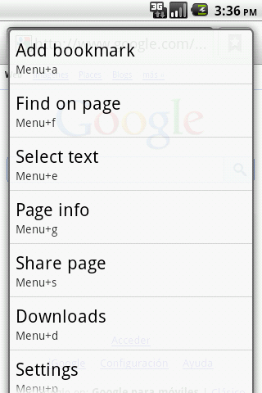
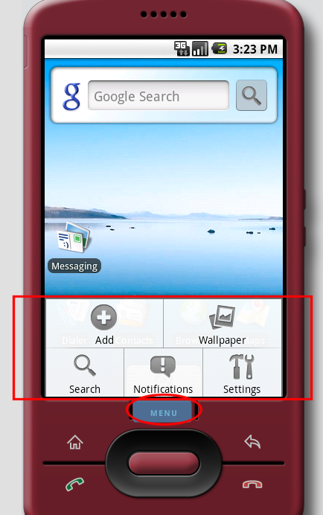
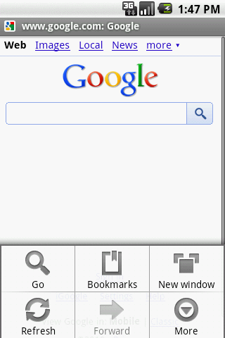
8. Android – UI – Using Menus
Using Menus
Example: Using an option menu
Options
available in
this context
Press Menu
button
A max of six entries per menu. Excess will be displayed as part of the More option
39

Slide 40
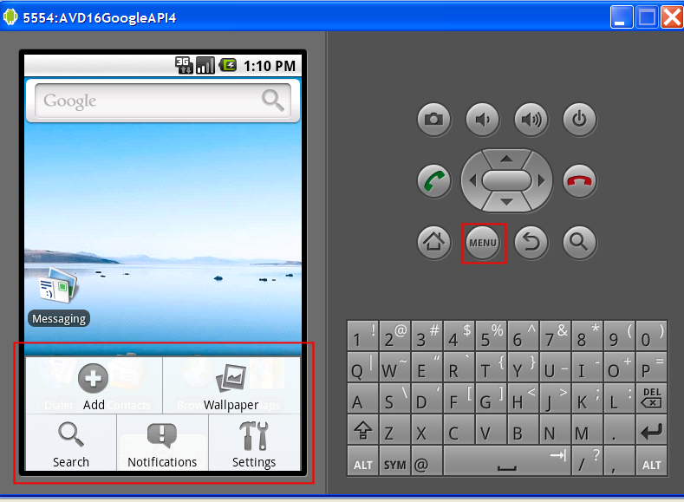
8. Android – UI – Using Menus
Using Menus
Example:
Using an option menu
Five available
Options in
this context
Press Menu
button
40

Slide 41
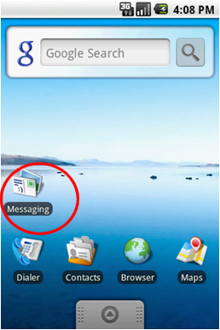
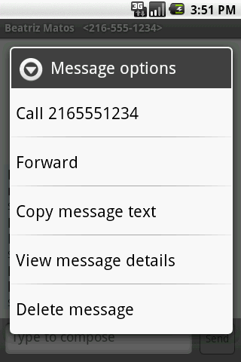
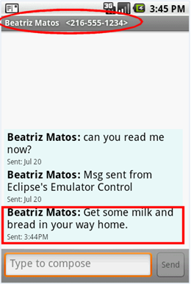
8. Android – UI – Using Menus
Using Menus
Example :
Dealing with SMS (text-messages) by using the built-in Messaging app’s
context menu
Available options
Tap-&-Hold
41

Slide 42
8. Android – UI – Using Menus
Using Menus
Observation:
Option and Context Menus may include:
Text
Icons
Radio Buttons
Check Boxes
Sub-menus
Short-cut keys
42

Slide 43
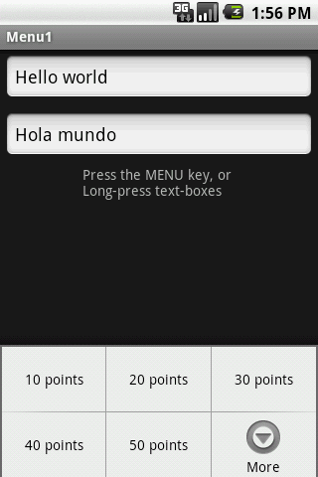
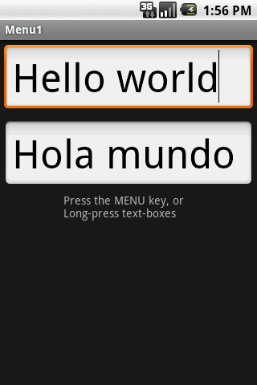
8. Android – UI – Using Menus
Using Menus
Example 1: Using an Option Menu
In this application the
Option menu offers
a way of changing the
text size (on both
EditText boxes)
Click on Menu button to see size options
After choosing option:
50 points
43

Slide 44
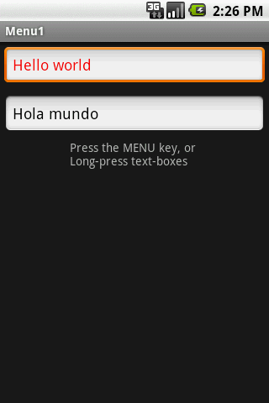
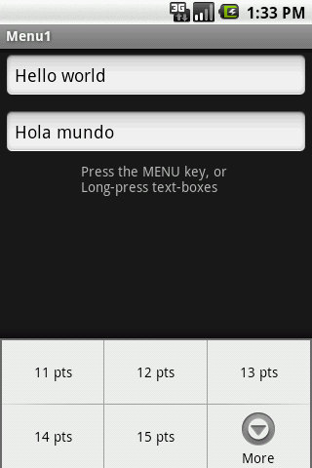
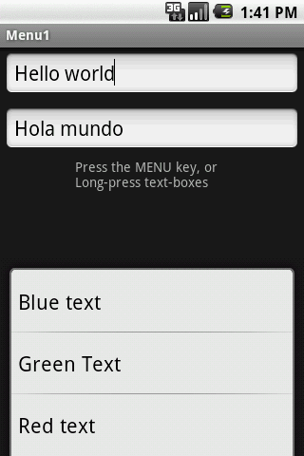
8. Android – UI – Using Menus
Using Menus
Example 1: Using an Option Menu
Up to six options will
Be displayed on the
Option menu.
If there are more than six options pushing the More button will show the rest
Click the More button to see additional options
Additional choices of the Option menu
44

Slide 45
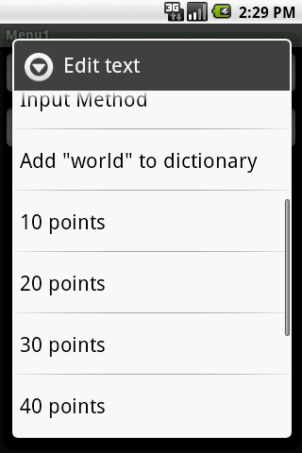
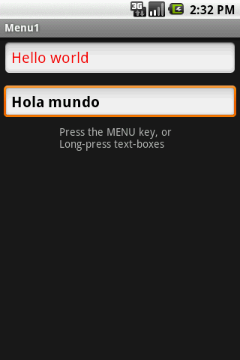
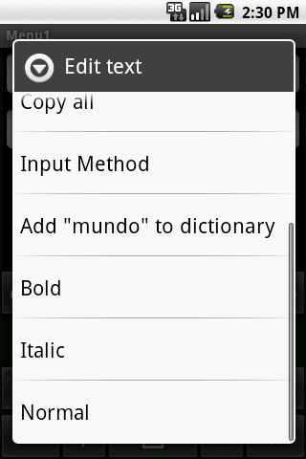
8. Android – UI – Using Menus
Using Menus
Example 1: Using a Context Menu
Each view could have an associated
Context Menu
Long-press a textbox to invoke its Context Menu
45

Slide 46
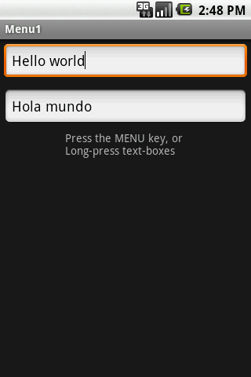
8. Android – UI – Using Menus
Using Menus
Example 1: Using Option and Context Menu
The app shows two text boxes. Menus are used to change text’s size, color, and style.
<?xml version="1.0" encoding="utf-8"?>
<LinearLayout xmlns:android="http://schemas.android.com/apk/res/android"
android:orientation="vertical"
android:layout_width="fill_parent"
android:layout_height="fill_parent“ >
<EditText
android:id="@+id/etMessage1"
android:text="Hello world"
android:layout_width="fill_parent"
android:layout_height="wrap_content"
android:layout_margin = "5dp" />
<EditText
android:id="@+id/etMessage2"
android:text="Hola mundo"
android:layout_width="fill_parent"
android:layout_height="wrap_content"
android:layout_margin = "5dp" />
<TextView
android:text="Press the MENU key, or \nLong-press text-boxes"
android:layout_width="wrap_content"
android:layout_height="wrap_content"
android:layout_gravity="center" />
</LinearLayout>
46

Slide 47
8. Android – UI – Using Menus
Using Menus
Example 1: Using Option and Context Menu
The app shows two text boxes. Menus are used to change text’s size, color, and style.
package cis493.matos.menu;
// using Menus (Option & Context)
import android.app.Activity; …
public class Menu1Act1 extends Activity {
EditText etMessage1;
EditText etMessage2;
Integer[] arrayPointSize = {10, 20, 30, 40, 50};
@Override
public void onCreate(Bundle savedInstanceState) {
super.onCreate(savedInstanceState);
setContentView(R.layout.main);
etMessage1 = (EditText)findViewById(R.id.etMessage1);
etMessage2 = (EditText)findViewById(R.id.etMessage2);
// you may register an individual context menu for each view
registerForContextMenu(etMessage1);
registerForContextMenu(etMessage2);
} //onCreate
47

Slide 48
8. Android – UI – Using Menus
Using Menus
Example 1: Using Option and Context Menu
The app shows two text boxes. Menus are used to change text’s size, color, and style.
// set the option menu for the current activity
@Override
public boolean onCreateOptionsMenu(Menu menu) {
// only one Option menu per activity
populateMyFirstMenu(menu);
return super.onCreateOptionsMenu(menu);
}
// detect what view is calling and create its context menu
@Override
public void onCreateContextMenu(ContextMenu menu, View v,
ContextMenuInfo menuInfo) {
super.onCreateContextMenu(menu, v, menuInfo);
// decide what context menu needs to be made
if (v.getId() == etMessage1.getId())
// create a menu for etMessage1 box
populateMyFirstMenu(menu);
if (v.getId() == etMessage2.getId()){
// create a menu for etMessage2 box
populateMySecondMenu(menu);
}
} //onCreateContextMenu
48

Slide 49
8. Android – UI – Using Menus
Using Menus
Example 1: Using Option and Context Menu
The app shows two text boxes. Menus are used to change text’s size, color, and style.
private void populateMyFirstMenu(Menu menu){
int groupId = 0; int order= 0;
//arguments: groupId, optionId, order, title
menu.add(groupId, 1, 1, "10 points");
menu.add(groupId, 2, 2, "20 points");
menu.add(groupId, 3, 3, "30 points");
menu.add(groupId, 4, 4, "40 points");
menu.add(groupId, 5, 5, "50 points");
menu.add(groupId, 6, 8, "Red text");
menu.add(groupId, 7, 7, "Green Text");
menu.add(groupId, 8, 6, "Blue text");
} //populateMyMenu
private void populateMySecondMenu(Menu menu){
int groupId = 0; int order= 0;
//arguments: groupId, optionId, order, title
menu.add(groupId, 9, 1, "Bold");
menu.add(groupId, 10, 2, "Italic");
menu.add(groupId, 11, 3, "Normal");
}//populateMySecondMenu
49

Slide 50
8. Android – UI – Using Menus
Using Menus
Example 1: Using Option and Context Menu
The app shows two text boxes. Menus are used to change text’s size, color, and style.
// called whenever an item in your context menu is selected
@Override
public boolean onContextItemSelected(MenuItem item) {
return(applyMenuOption(item) ||
super.onContextItemSelected(item) );
}
// called whenever an item in your options menu is selected
@Override
public boolean onOptionsItemSelected(MenuItem item) {
return(applyMenuOption(item) ||
super.onOptionsItemSelected(item) );
}
Note: boolean event observers of the type onEvent(. . . ) by convention return true to indicate the triggered event has been consumed by the method, when false is returned the event is still alive and could be consumed by others.
50

Slide 51
8. Android – UI – Using Menus
Using Menus
Example 1: Using Option and Context Menu
// apply the action associated to selected item
private boolean applyMenuOption(MenuItem item){
int menuItemId = item.getItemId(); // 1, 2, 3, ...11
String strMsg2 = etMessage2.getText().toString();
if (menuItemId <= 5) {
// first five option are for setting text size
int newPointSize = arrayPointSize[menuItemId - 1];
etMessage1.setTextSize(newPointSize);
etMessage2.setTextSize(newPointSize);
}
else {
// either change color on box text1 or style on text2
if (menuItemId == 6)
etMessage1.setTextColor(color.background_dark | Color.RED);
etMessage1.setTextColor(0xffff0000); // red
else if (menuItemId == 7)
etMessage1.setTextColor(0xff00ff00); // green
else if (menuItemId == 8)
etMessage1.setTextColor(0xff0000ff); // blue
else if (menuItemId == 9)
etMessage2.setText(beautify(strMsg2, "BOLD")); //bold
else if (menuItemId == 10)
etMessage2.setText(beautify(strMsg2, "ITALIC")); //italic
else if (menuItemId == 11)
etMessage2.setText(beautify(strMsg2, "NORMAL")); //normal
}
return false;
} //applyMenuOption
51

Slide 52
8. Android – UI – Using Menus
Using Menus
Example 1: Using Option and Context Menu
The app shows two text boxes. Menus are used to change text’s size, color, and style.
// changing text style using HTML formatting
// Spanned is text to which you could add formatting features
private Spanned beautify (String originalText, String selectedStyle){
Spanned answer = null;
if (selectedStyle.equals("BOLD"))
answer = Html.fromHtml("<b>" + originalText +"</b");
else if (selectedStyle.equals("ITALIC"))
answer = Html.fromHtml("<i>" + originalText +"</i>");
else if (selectedStyle.equals("NORMAL"))
answer = Html.fromHtml("<normal>" + originalText +"</normal");
return answer;
} //beautify
} //Menu1Act1
52

Slide 53
8. Android – UI – Using Menus
Using Menus
Comments on Creating an Option & Context Menu
Step1.
Indicate which widget(s) on your activity have context menus. To do this, call registerForContextMenu(theWidget)
supplying the View that is the widget needing a context menu.
Step2.
Implement onCreateContextMenu(…), populate your menu adding text, icons, etc. to the different options. Use input menu parameter to determine which menu to build (assuming your activity has more than one).
The onCreateContextMenu() method gets the ContextMenu itself, the View the
context menu is associated with, and a ContextMenu.ContextMenuInfo, which
tells you which item in the list the user did the tap-and-hold over, in case
you want to customize the context menu based on that information
53
53

Slide 54
8. Android – UI – Using Menus
Using Menus
Comments on Creating an Option & Context Menu
onCreateContextMenu() is called each time the context menu is requested.
Unlike the options menu (which is only built once per activity), context menus are discarded once they are used or dismissed.
To find out when a context menu choice was chosen, implement onContextItemSelected() on the activity.
54
54

Slide 55
8. Android – UI – Using Menus
Using Menus
Comments on Creating an Option & Context Menu
In Example1 the event observers:
onOptionsItemSelected() (for options menu selections) and
onContextItemSelected() (for context menu selections)
delegate on the applyMenuChoice(…) method the performing of the actions associated to the choices made by the user.
@Override
public boolean onOptionsItemSelected(MenuItem item) {
return (applyMenuChoice(item) );
}
@Override
public boolean onContextItemSelected(MenuItem item) {
return (applyMenuChoice(item));
}
55
55

Slide 56
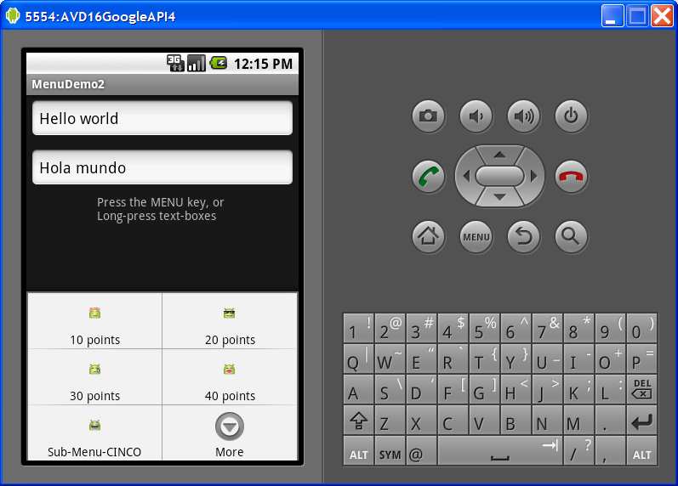
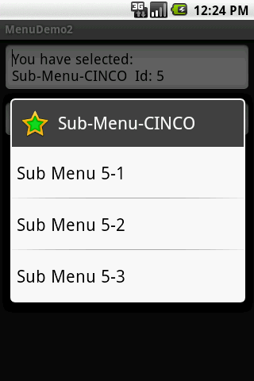
8. Android – UI – Using Menus
Using Menus
Extending Example1.
Example 2: Enhancing Option/Context Menu
This extension of the previous example adds icons and links to the Option Menu entries, as well as a sub-menu list tied to one the option menu buttons.
Keyboard shortcuts / links
Click on SubMenu to see additional options
56

Slide 57
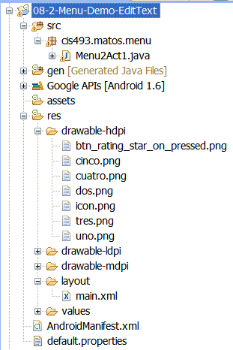
8. Android – UI – Using Menus
Using Menus
Extending Example1.
Example 2: Enhancing Option/Context Menu
This extension of the previous example adds icons and links to the Option Menu entries, as well as a sub-menu list tied to one the option menu buttons.
57

Slide 58
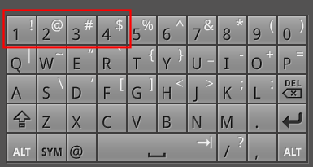
8. Android – UI – Using Menus
Using Menus
Extending Example1.
Example 2: Enhancing Option/Context Menu
Replace the method
populateMyFirstMenu
with the following code
private void populateMyFirstMenu(Menu menu){
int groupId = 0;
//arguments: groupId, optionId, order, title
MenuItem item1 = menu.add(groupId, 1, 1, "10 points");
MenuItem item2 = menu.add(groupId, 2, 2, "20 points");
MenuItem item3 = menu.add(groupId, 3, 3, "30 points");
MenuItem item4 = menu.add(groupId, 4, 4, "40 points");
//MenuItem item5 = menu.add(groupId, 5, 5, "50 points");
MenuItem item6 = menu.add(groupId, 6, 8, "Red text");
MenuItem item7 = menu.add(groupId, 7, 7, "Green Text");
MenuItem item8 = menu.add(groupId, 8, 6, "Blue text");
//set icons
item1.setIcon(R.drawable.uno);
item2.setIcon(R.drawable.dos);
item3.setIcon(R.drawable.tres);
item4.setIcon(R.drawable.cuatro);
// shortcuts using device’s keyboard-keypad
// on a G1 open slide open the keyboard and
// type letter u (same as pressing menu UNO)
item1.setShortcut('1', '1');
item2.setShortcut('2', '2');
item3.setShortcut('3', '3');
item4.setShortcut('4', '4');
Remove this line from previous version
Figures used in this example were taken from:
C:\android-sdk-windows\platforms\android-4\data\res\drawable
58

Slide 59
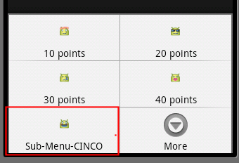
8. Android – UI – Using Menus
Using Menus
Extending Example1.
Continuation…
Replace the method
populateMyFirstMenu
with the following code
Example 2: Enhancing Option/Context Menu
// adding a sub-menu as fifth entry of this menu
// .addSubMenu(int groupId, int itemId, int order, CharSequence title)
int smGroupId = 0; // don't care, same as Menu.NONE
int smItemId = 5; // fifth element
int smOrder = 5; // don't care, same as Menu.NONE
SubMenu mySubMenu5 = menu.addSubMenu(smGroupId, smItemId, smOrder, "Sub-Menu-CINCO");
mySubMenu5.setHeaderIcon(R.drawable.btn_rating_star_on_pressed);
mySubMenu5.setIcon(R.drawable.cinco);
// .add(int groupId, int itemId, int order, CharSequence title)
MenuItem sub51 = mySubMenu5.add(smGroupId,5,1,"Sub Menu 5-1");
MenuItem sub52 = mySubMenu5.add(smGroupId,5,2,"Sub Menu 5-2");
MenuItem sub53 = mySubMenu5.add(smGroupId,5,3,"Sub Menu 5-3");
} //populateMyFirstMenu
59

Slide 60
8. Android – UI – Using Menus
Using Menus
Extending Example1.
Continuation…
Replace the method
applyMenuOption
with the following code
Example 2: Enhancing Option/Context Menu
private boolean applyMenuOption(MenuItem item){
int menuItemId = item.getItemId(); //1, 2, 3, ...11
String strMsg2 = etMessage2.getText().toString();
if (menuItemId < 5) {
// first four options are for setting text size
int newPointSize = arrayPointSize[menuItemId - 1];
etMessage1.setTextSize(newPointSize);
etMessage2.setTextSize(newPointSize);
}
else if (menuItemId == 5) {
// the sub-menu (attached to 5th item) is processed here
etMessage1.setText (
"You have selected: \n" +item.getTitle()
+ "\nId: " + menuItemId
+ " order: " + item.getOrder() );
}
// either change color on text1 or style on text2
else if (menuItemId == 6)
etMessage1.setTextColor(0xffff0000); // red
Same as before
Take care of sub-menu here
60

Slide 61
8. Android – UI – Using Menus
Using Menus
Extending Example1.
Continuation…
Replace the method
applyMenuOption
with the following code
Example 2: Enhancing Option/Context Menu
else if (menuItemId == 7)
etMessage1.setTextColor(0xff00ff00); // green
else if (menuItemId == 8)
etMessage1.setTextColor(0xff0000ff); // blue
else if (menuItemId == 9)
etMessage2.setText(beautify(strMsg2, "BOLD")); //bold
else if (menuItemId == 10)
etMessage2.setText(beautify(strMsg2, "ITALIC")); //italic
else if (menuItemId == 11)
etMessage2.setText(beautify(strMsg2, "NORMAL")); //normal
return false;
} //applyMenuOption
Same as before
61

Slide 62
Android Dialog Boxes AlertDialog - Toast
11
Notes are based on:
Android Developers
http://developer.android.com/index.html

Slide 63
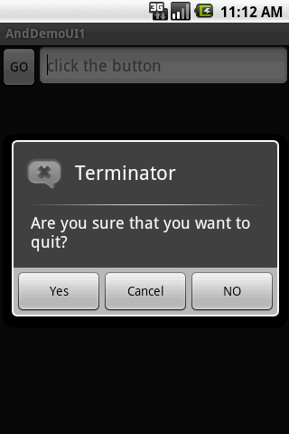
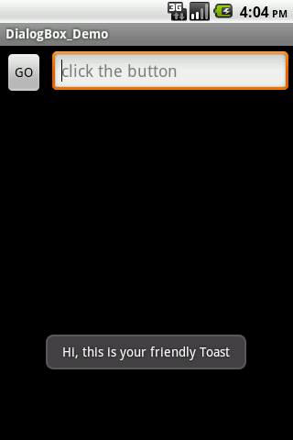
11. Android – UI – The DialogBox
The DialogBox
Android provides two primitive forms of dialog boxes:
AlertDialog boxes, and
Toast controls
63

Slide 64
11. Android – UI – The DialogBox
The AlertDialog
The AlertDialog is an almost modal screen that
presents a brief message to the user typically shown as a small floating window that partially obscures the underlying view, and
collects a simple answer (usually by clicking an option button) .
Note:
A modal view remains on the screen waiting for user’s input. The rest of the application is on hold. It has to be dismissed by an explicit user’s action.
64
64

Slide 65

11. Android – UI – The DialogBox
The AlertDialog
Warning !!!
An AlertDialog is NOT a typical inputBox (as in .NET)
Why?
An AlertDialog box is modal as it needs user intervention to be terminated
However
it does not stop the main thread (code following the call to show the DialogAlert box is executed without waiting for the user’s input)
65

Slide 66
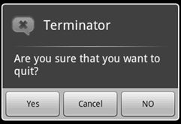
11. Android – UI – The DialogBox
The AlertDialog
Example:
Icon
Title
Negative
Button
Message
Neutral
Button
Positive
Button
66

Slide 67
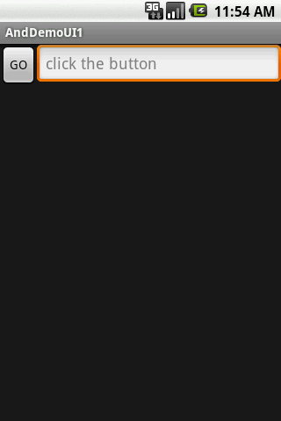
11. Android – UI – The DialogBox
The AlertDialog
Example: A simple Dialog Box
<LinearLayout
android:id="@+id/LinearLayout01"
android:layout_width="fill_parent"
android:layout_height="fill_parent"
xmlns:android="http://schemas.android.com/apk/res/android"
android:orientation="horizontal">
<Button
android:text="GO"
android:id="@+id/btnGo"
android:layout_width="wrap_content"
android:layout_height="wrap_content">
</Button>
<EditText
android:hint="click the button"
android:id="@+id/txtMsg"
android:layout_width="fill_parent"
android:layout_height="wrap_content">
</EditText>
</LinearLayout>
67

Slide 68
11. Android – UI – The DialogBox
The AlertDialog
Example: A simple dialog box
package cis493.selectionwidgets;
import android.app.Activity;
import android.app.AlertDialog;
import android.content.DialogInterface;
import android.os.Bundle;
import android.view.View;
import android.view.View.OnClickListener;
import android.widget.Button;
import android.widget.EditText;
public class AndDemoUI1 extends Activity {
Button btnGo;
EditText txtMsg;
String msg;
68

Slide 69
11. Android – UI – The DialogBox
The AlertDialog
Example: A simple dialog box
@Override
public void onCreate(Bundle savedInstanceState) {
super.onCreate(savedInstanceState);
setContentView(R.layout.main);
txtMsg = (EditText)findViewById(R.id.txtMsg);
btnGo = (Button) findViewById(R.id.btnGo);
btnGo.setOnClickListener(new OnClickListener() {
@Override
public void onClick(View arg0) {
AlertDialog dialBox = createDialogBox();
dialBox.show();
// WARNING: (in general...)
// after showing a dialog you should have NO more code. Let the buttons of
// the dialog box handle the rest of the logic. For instance, in this
// example a modal dialog box is displayed (once shown you can not do
// anything to the parent until the child is closed) however the code in
// the parent continues to execute after the show() method is
// called.
txtMsg.setText("I am here!");
}
});
}//onCreate
69

Slide 70
11. Android – UI – The DialogBox
The AlertDialog
Example: A simple dialog box
private AlertDialog createDialogBox(){
AlertDialog myQuittingDialogBox =
new AlertDialog.Builder(this)
//set message, title, and icon
.setTitle("Terminator")
.setMessage("Are you sure that you want to quit?")
.setIcon(R.drawable.ic_menu_end_conversation)
//set three option buttons
.setPositiveButton("Yes", new DialogInterface.OnClickListener() {
public void onClick(DialogInterface dialog, int whichButton) {
//whatever should be done when answering "YES" goes here
msg = "YES " + Integer.toString(whichButton);
txtMsg.setText(msg);
}
})//setPositiveButton
70

Slide 71
11. Android – UI – The DialogBox
The AlertDialog
Example: A simple dialog box
.setNeutralButton("Cancel",new DialogInterface.OnClickListener() {
public void onClick(DialogInterface dialog, int whichButton) {
//whatever should be done when answering "CANCEL" goes here
msg = "CANCEL " + Integer.toString(whichButton);
txtMsg.setText(msg);
}//OnClick
})//setNeutralButton
.setNegativeButton("NO", new DialogInterface.OnClickListener() {
public void onClick(DialogInterface dialog, int whichButton) {
//whatever should be done when answering "NO" goes here
msg = "NO " + Integer.toString(whichButton);
txtMsg.setText(msg);
}
})//setNegativeButton
.create();
.return myQuittingDialogBox;
}// createDialogBox
}// class
71

Slide 72
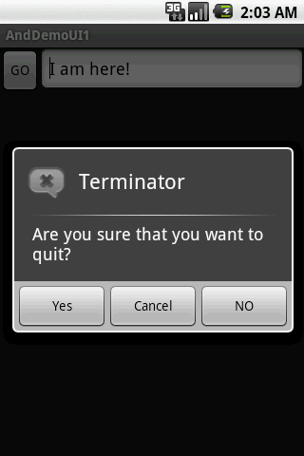
11. Android – UI – The DialogBox
The AlertDialog
Example: A simple AlertDialog box
This text is set right after showing the dialog box
72

Slide 73
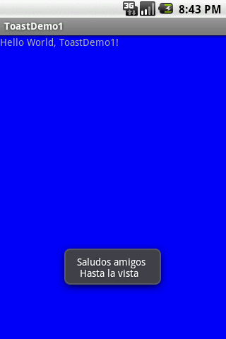
11. Android – UI – The DialogBox
The Toast View
A Toast is a transient view containing a quick little message for the user.
They appear as a floating view over the application.
They never receive focus.
73

Slide 74
11. Android – UI – The DialogBox
The Toast View
Example: A simple Toast
Toast.makeText ( context, message, duration ).show();
Context: A reference to the view’s environment (what is around me…)
Message: The thing you want to say
Duration: SHORT or LONG exposure
74

Slide 75
11. Android – UI – The DialogBox
The Toast View
Example: A simple Toast
package cis493.dialogboxes;
import android.app.Activity;
import android.os.Bundle;
import android.widget.Toast;
public class ToastDemo1 extends Activity {
/** Called when the activity is first created. */
@Override
public void onCreate(Bundle savedInstanceState) {
super.onCreate(savedInstanceState);
setContentView(R.layout.main);
Toast.makeText(
getApplicationContext(),
"Saludos amigos \n Hasta la vista",
Toast.LENGTH_LONG).show();
}
}
75

Slide 76
11. Android – UI – The DialogBox
The Toast View
As an aside
Context:
On Android a Context is mostly used to load and access resources.
All widgets receive a Context parameter in their constructor.
In a regular Android application, you usually have two kinds of Context, Activity and Application. The first one is typically passed to classes
and methods that need a Context.
Views have a reference to the entire activity and therefore to anything your
activity is holding onto; usually the entire View hierarchy and all its resources.
76

Slide 77
11. Android – UI – The DialogBox
The Toast View
Customizing a Toast View
By default Toast views are displayed at the center-bottom of the screen.
However the user may change the placement of a Toast view by using either of the following methods:
void setGravity (int gravity, int xOffset, int yOffset)
Set the location at which the notification should appear on the screen.
void setMargin (float horizontalMargin, float verticalMargin)
Set the margins of the view.
77

Slide 78
11. Android – UI – The DialogBox
The Toast View
Customizing a Toast View
The following method uses offset values based on the pixel resolution of the actual device. For instance, the G1 phone screen contains 360x480 pixels.
void setGravity (int gravity, int xOffset, int yOffset)
Gravity: Overall placement. Typical values include: Gravity.CENTER, Gravity.TOP,
Gravity.BOTTOM, …
xOffset: Assume Gravity.CENTER placement on a G1 phone. The xOffset range is -160,…,0,…160 (left, center, right)
yOffset: The range on a G1 is: -240,…,0,…240 (top, center, bottom)
78

Slide 79
11. Android – UI – The DialogBox
The Toast View
Customizing the Toast View
A second method to place a Toast is setMargin. The screen is considered to have a center point where horizontal and vertical center lines meet. There is 50% of the screen to each side of that center point (top, botton, left, right). Margins are expressed as a value between: -50,…, 0, …, 50.
void setMargin (float horizontalMargin, float verticalMargin)
Note:
The pair of margins (-50, -50) represent the upper-left corner of the screen,
(0, 0) is the center, and (50, 50) the lower-right corner.
79

Slide 80
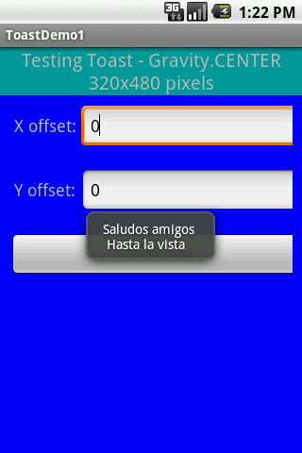
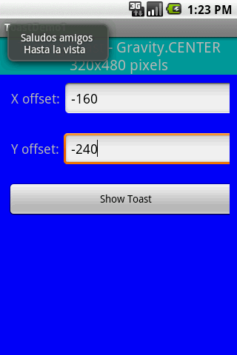
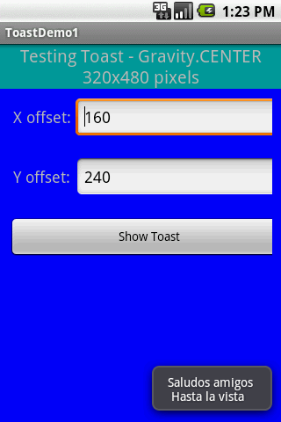
11. Android – UI – The DialogBox
The Toast View
Example: Changing the placement of a Toast view.
Using the setGravity(…) method with Gravity.CENTER, and x and y offsets of (resp.):
0, 0 (center)
-160, -240 (top-left)
160, 240 (right-bottom)
80

Slide 81
11. Android – UI – The DialogBox
The Toast View
Example: Changing the placement of a Toast view.
<?xml version="1.0" encoding="utf-8"?>
<TableLayout
android:id="@+id/myTableLayout"
android:layout_width="fill_parent"
android:layout_height="fill_parent"
android:background="#ff0000ff"
android:orientation="vertical"
android:stretchColumns="1,2"
xmlns:android="http://schemas.android.com/apk/res/android"
>
<TableRow
android:id="@+id/myRow1"
android:layout_width="fill_parent"
android:layout_height="wrap_content"
android:orientation="horizontal"
>
<TextView
android:id="@+id/myCaption"
android:layout_width="fill_parent"
android:layout_height="wrap_content"
android:background="#ff009999"
android:text="Testing Toast - Gravity.CENTER 320x480 pixels"
android:textSize="20sp"
android:gravity="center"
android:layout_span="2"
>
</TextView>
</TableRow>
<TableRow
android:id="@+id/myRow1"
android:layout_width="fill_parent"
android:layout_height="wrap_content"
android:background="#ff0000ff"
android:padding="10px"
android:orientation="horizontal"
>
<TextView
android:id="@+id/xLabel"
android:layout_width="wrap_content"
android:layout_height="wrap_content"
android:text=" X offset: "
android:textSize="18sp"
>
</TextView>
<EditText
android:id="@+id/xBox"
android:layout_width="wrap_content"
android:layout_height="wrap_content"
android:text="0"
android:textSize="18sp"
android:inputType="numberSigned"
>
</EditText>
</TableRow>
<TableRow
android:id="@+id/myRow2"
android:layout_width="fill_parent"
android:layout_height="wrap_content"
android:background="#ff0000ff"
android:padding="10px"
android:orientation="horizontal"
>
<TextView
android:id="@+id/yLabel"
android:layout_width="wrap_content"
android:layout_height="wrap_content"
android:text=" Y offset: "
android:textSize="18sp"
>
</TextView>
<EditText
android:id="@+id/yBox"
android:layout_width="wrap_content"
android:layout_height="wrap_content"
android:text="0"
android:textSize="18sp"
android:inputType="numberSigned"
>
</EditText>
</TableRow>
<TableRow
android:id="@+id/myRow3"
android:layout_width="fill_parent"
android:layout_height="wrap_content"
android:background="#ff0000ff"
android:padding="10px"
android:orientation="horizontal"
>
<Button
android:id="@+id/btn1"
android:layout_width="wrap_content"
android:layout_height="wrap_content"
android:text=" Show Toast "
android:layout_span="2"
>
</Button>
</TableRow>
</TableLayout>
81

Slide 82
11. Android – UI – The DialogBox
The Toast View
Example: Changing the placement of a Toast view.
package cis493.dialogboxes;
import android.app.Activity;
import android.os.Bundle;
import android.view.Gravity;
import android.view.View;
import android.view.View.OnClickListener;
import android.widget.Button;
import android.widget.EditText;
import android.widget.Toast;
public class ToastDemo1 extends Activity {
EditText xBox;
EditText yBox;
Button btn1;
@Override
public void onCreate(Bundle savedInstanceState) {
super.onCreate(savedInstanceState);
setContentView(R.layout.main2);
xBox = (EditText)findViewById(R.id.xBox);
yBox = (EditText)findViewById(R.id.yBox);
82

Slide 83
11. Android – UI – The DialogBox
The Toast View
Example: Changing the placement of a Toast view.
btn1 = (Button)findViewById(R.id.btn1);
btn1.setOnClickListener(new OnClickListener() {
@Override
public void onClick(View v) {
try {
Toast myToast = Toast.makeText(
getApplicationContext(),
"Saludos amigos \n Hasta la vista",
Toast.LENGTH_LONG);
myToast.setGravity(Gravity.CENTER,
Integer.valueOf(xBox.getText().toString()),
Integer.valueOf(yBox.getText().toString()) );
myToast.show();
} catch (NumberFormatException e) {
Toast.makeText(getApplicationContext(),
e.getMessage(),
Toast.LENGTH_LONG).show();
}
}// onClick
}); // listener
}// onCreate
}// class
83

Slide 84
11. Android – UI – The DialogBox
The Toast View
Example: Showing Fancy Toast views.
Toasts could be modified to display a custom combination of color/shape/text/background.
You need to follow the next steps:
Define the XML layout of the new custom view
Make sure there is a TextView named: text
Additionally you could attach an android: background to the TextView.
The background could be a figure (such as a .png file) or an XML defined shape (see next example).
Example taken from:
http://hustleplay.wordpress.com/2009/07/23/replicating-default-android-toast/
84

Slide 85
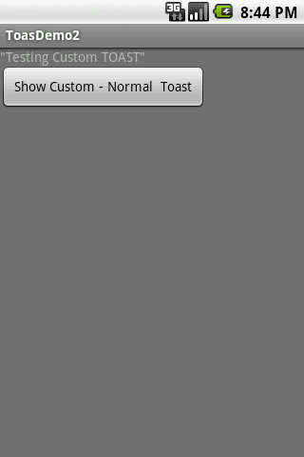
11. Android – UI – The DialogBox
The Toast View
Example: Showing Fancy Toast views.
Let’s begin with the application’s main layout.
<?xml version="1.0" encoding="utf-8"?>
<LinearLayout xmlns:android="http://schemas.android.com/apk/res/android"
android:orientation="vertical"
android:layout_width="fill_parent"
android:layout_height="fill_parent"
android:background="#777"
>
<TextView
android:layout_width="fill_parent"
android:layout_height="wrap_content"
android:text='"Testing Custom TOAST"'/>
<Button
android:layout_width="wrap_content"
android:layout_height="wrap_content"
android:id="@+id/btnShowToast"
android:text=" Show Custom - Normal Toast ">
</Button>
</LinearLayout>
85

Slide 86
11. Android – UI – The DialogBox
The Toast View
Example: Showing Fancy Toast views.
Now we create our custom Toast layout (called: my_toast_layout.xml. It must contain a TextView called ‘text’)
<?xml version="1.0" encoding="utf-8"?>
<LinearLayout xmlns:android="http://schemas.android.com/apk/res/android"
android:id="@+id/my_toast_layout_root"
android:orientation="horizontal"
android:layout_width="fill_parent"
android:layout_height="fill_parent"
android:padding="10dp"
>
<TextView
android:id="@+id/text"
android:layout_width="wrap_content"
android:layout_height="wrap_content"
android:padding="20dp"
android:background="@drawable/my_border"
>
</TextView>
</LinearLayout>
Required TextView
Optional background
86

Slide 87
11. Android – UI – The DialogBox
The Toast View
Example: Showing Fancy Toast views.
Finally we take care of the optional background element (my_border.xml). In this example we define a <shape> (but it could be any .png image). This XML (or image) is saved in the folder: /res/drawable
<?xml version="1.0" encoding="UTF-8" ?>
<shape
xmlns:android="http://schemas.android.com/apk/res/android"
android:shape="rectangle">
<stroke android:width="2dp" android:color="#ffffff00" />
<solid android:color="#ff990000" />
<padding android:left="10dp" android:top="4dp"
android:right="10dp" android:bottom="4dp" />
<corners android:radius="15dp" />
</shape>
87

Slide 88
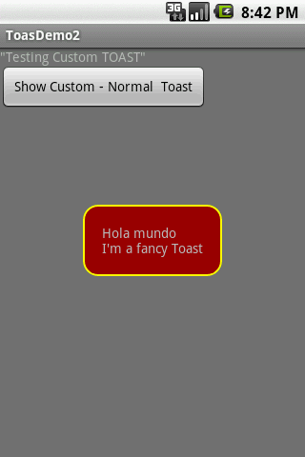
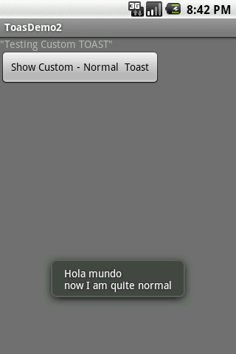
11. Android – UI – The DialogBox
The Toast View
Example: Showing Fancy Toast views.
Testing the application
A Toast displayed with our custom layout
A Toast displayed using standard formatting
88

Slide 89
11. Android – UI – The DialogBox
The Toast View
Example: Showing Fancy Toast views.
package cis493.dialogboxes;
import android.app.Activity;
import android.os.Bundle;
import android.view.Gravity;
import android.view.LayoutInflater;
import android.view.View;
import android.view.ViewGroup;
import android.view.View.OnClickListener;
import android.widget.Button;
import android.widget.TextView;
import android.widget.Toast;
public class ToastDemo2 extends Activity {
@Override
public void onCreate(Bundle savedInstanceState) {
super.onCreate(savedInstanceState);
setContentView(R.layout.main);
89

Slide 90
11. Android – UI – The DialogBox
The Toast View
Example: Showing Fancy Toast views.
Button btnShowToast = (Button) findViewById(R.id.btnShowToast);
btnShowToast.setOnClickListener(new OnClickListener() {
@Override
public void onClick(View v) {
//custom made TOAST
LayoutInflater inflater = getLayoutInflater();
View layout = inflater.inflate(
R.layout.my_toast_layout,
(ViewGroup) findViewById(R.id.my_toast_layout_root));
TextView text = (TextView) layout.findViewById(R.id.text);
Toast toast = new Toast(getApplicationContext());
text.setText("Hola mundo \nI'm a fancy Toast");
toast.setGravity(Gravity.CENTER, 0, 0);
toast.setDuration(Toast.LENGTH_SHORT);
toast.setView(layout);
toast.show();
// normal TOAST
Toast.makeText(getApplicationContext(),
"Hola mundo \nnow I am quite normal",
Toast.LENGTH_SHORT).show();
}
});
}
}
90

Slide 91
11. Android – UI – The DialogBox
The Toast View
Example: Showing Fancy Toast views.
As an aside:
Inflating a View
You may want occasionally to modify the way Android renders a particular view (perhaps a different color, style, or shape).
Once the Hierarchy View has been displayed, you can take any terminal node and extend it by inflating a custom ‘view sub-tree’. Also, by using layout inflation we may draw a new Hierarchy on top of the existing screen.
In our example, our customized rendition of a Toast box (including a colorful background) is defined in an XML file. Depicting the image of the custom Toast is accomplished by inflating the XML layout spec.
91

Slide 92
11. Android – UI – The DialogBox
The Toast View
Example: Showing Fancy Toast views.
As an aside:
Inflating a View
Syntaxt
public View inflate (int resource, ViewGroup root)
Inflate a new view hierarchy from the specified xml resource.
Parameters
resource ID for an XML layout resource to load, root: optional view to be the parent of the generated hierarchy.
Returns
The root View of the inflated hierarchy. If root was supplied, this is the root View; otherwise it is the root of the inflated XML file.
LayoutInflater inflater = getLayoutInflater();
View layout = inflater.inflate(
R.layout.my_toast_layout,
(ViewGroup) findViewById(R.id.my_toast_layout_root));
TextView text = (TextView) layout.findViewById(R.id.text);
92

